Slide 1
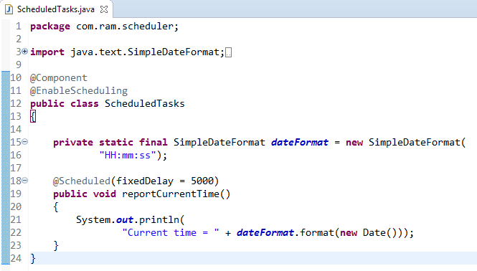
Schedule a Task at Fixed Delay [Configuring scheduled tasks using Annotation]
@EnableScheduling ensures that a background task executor is created. Without it, nothing gets scheduled.
Here we have configured a task to run after a fixed delay.
In this case, the duration between the end of last execution and the start of next execution is fixed. The task always waits until the previous one is finished.
This option should be used when it’s mandatory that the previous execution is completed before running again.
The simple rules that need to be followed to annotate a method with @Scheduled are:
a method should have void return type
a method should not accept any parameters
Hardcoding these schedules is simple, but usually, you need to be able to control the schedule without re-compiling and re-deploying the entire app.
We’ll make use of Spring Expressions to externalize the configuration of the tasks – and we’ll store these in properties files:
@Scheduled(fixedDelayString = "${fixedDelay.in.milliseconds}")

Slide 2
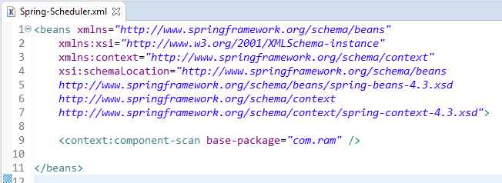
Schedule a Task at Fixed Delay [Configuring scheduled tasks using Annotation]

Slide 3
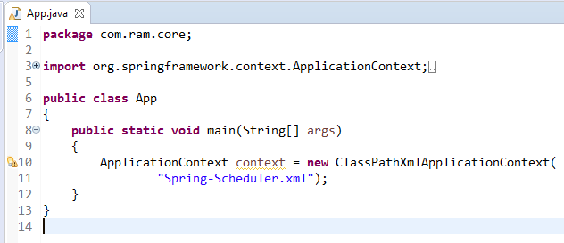
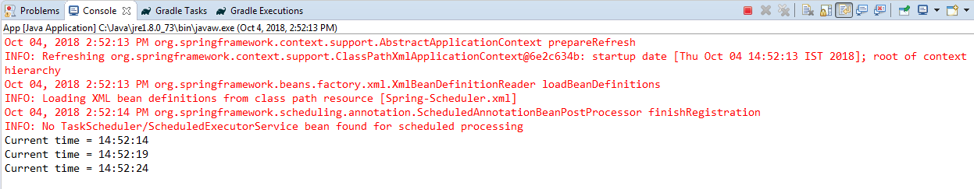
Schedule a Task at Fixed Delay [Configuring scheduled tasks using Annotation]

